Slide 1
The 2nd Annual Sub-Sahara Spectrum Management Conference DAKAR 7-8 November 2016
Eric Fournier
Chairman, Electronic Communications Committee

Slide 2
Spectrum harmonised for IMT
Band | Size (MHz) | ECC framework (main deliverables)
700 MHz (694- 790 MHz) | 2x30 + 20 (option 0 to 4 blocks of 5 MHz) (SDL) | ECC DEC(15)01
800 MHz (790-862 MHz) | 2x30 | ECC DEC(09)03
900 MHz (880-915 MHz /925-960 MHz) | 2x35 | ECC DEC(06)13
1452-1492 MHz | 40 (SDL) | ECC DEC(13)03
1.8 GHz (1710-1785 MHz/1805-1880 MHz) | 2x75 | ECC DEC(06)13
2 GHz (1920-1980MHz/2110-2170 MHz) | 2x60 | ECC DEC(06)01
2.3-2.4 GHz | 100 | ECC DEC(14)02
2.6 GHz (2500-2690 MHz) | 2x70+50 | ECC DEC(05)05
3.4-3.8 GHz | 400 | ECC DEC(11)06
 | Total : up to 1210 MHz

Slide 3
L band (1427-1518 MHz) Supplemental Downlink (SDL) in Europe
WRC-15 identified the band 1427-1518 MHz almost worldwide
1452-1492 MHz already harmonised in Europe for SDL
http://www.erodocdb.dk/Docs/doc98/official/pdf/ECCDEC1303.PDF
Already auctioned In Germany and Italy
SDL also the preferred solution in the band 1427-1452 MHz and 1492-1518 MHz
CEPT harmonisation decision by the end of 2017 in these 2 bands

Slide 4
700 MHz band in Europe
700 MHz band harmonised at CEPT and EU level
http://www.erodocdb.dk/Docs/doc98/official/pdf/ECCDEC1501.PDF
http://eur-lex.europa.eu/legal-content/EN/TXT/PDF/?uri=CELEX:32016D0687&from=EN
Protection of broadcasting : OOB of -42 dBm/8 MHz
Possibility of SDL in the band 738-758 MHz (up to 4 blocks of 5 MHz)
Germany and France have auctioned the spectrum in 2015
Draft EU Decision from Council and Parliament
to make mandatory the availability of 2x30 MHz for mobile in EU
to ensure availability of 470-694 MHz for broadcasting

Slide 5
Other usage in the 700 MHz band
ECC decision on broadband PPDR include the 700 MHz band
http://www.erodocdb.dk/Docs/doc98/official/pdf/ECCDEC1602.PDF
2x30 MHz can also be used for PPDR
Blocks of dedicated spectrum for PPDR : 2x3 MHz / 2x5 MHz
Up to national administrations to pick up what they need
Other possible usages outside the 2x30 MHz:
Wireless audio PMSE
2x3 MHz dedicated blocks for M2M/IoT

Slide 6
UHF TV band
Current replanning process of TV below 694 MHz based on bilateral/multilateral cross-border agreements
TV white space
Currently used for PMSE
ECC has developed ECC reports about WSD, but no harmonisation other than PMSE
Preparation of WRC-23 agenda item on 470-694 MHz in Region 1 will start only after WRC-19

Slide 7
RSPG opinion on 5G
Member States making recommendations
to the EC
3.4-3.8 GHz as
the primary band suitable for 5G
5G also needs bands
below 1 GHz (e.g. 700 MHz)
nationwide and indoor coverage
A need to ensure that technical and regulatory conditions for all bands already harmonised are fit for 5G
One “Pioneer” band above 24 GHz
Following considerations in PC of 3 possible bands : 26 GHz, 32 GHz and 42 GHz

Slide 8
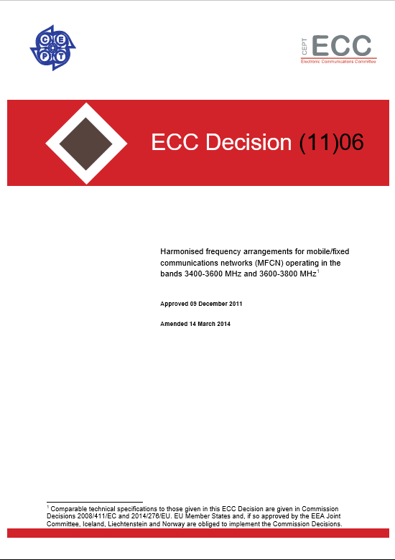
Prime 5G band : 3400-3800 MHz
3400-3800MHz
Check for 5G – Nov.2017
Indoor and outdoor coverage
(eirp 68 dBm/5 MHz)
Large carriers blocks
(20MHz, 40MHz and even more)
Few existing usage requiring some refarming (FBWA, P-P)

Slide 9
Spectrum for 5G above 24 GHz
WRC 19
24.25-27.5 GHz
31.8-33.4 GHz
37-43.5 GHz
45.5-50.2&50.4-52.6 GHz
66-76&81-86 GHz
?
WRC 15 AI 1.13 WRC 19
ECC/CPG prepare
positions for WRC 19
Which Frequency band(s)
for 5G in Europe?
RSPG opinion
on 5G
A pioneer band above 24 GHz harmonised < 2020
Other bands > WRC-19
5G Mandate
CEPT Report

Slide 10
Internet of Things
UNLICENSED
LICENSED
LTE-based M2M (LTE-eMTC)
1.4 MHz & 3 MHz
Narrowband M2M
EC-GSM-IoT and NB-IoT (200 kHz)
Existing/new spectrum in 800/900 MHz
RFID, 802.11AH, LPWA N(Sigfox, LoRa)
Checking that technical and regulatory conditions fit
all IoT technologies
Other unlicensed bands : 169 MHz, 433 MHz, 2.45 GHz, 5.8 GHz
PMR-IoT
400 MHz ? Other bands ?

Slide 11
WiFi
WRC-19 Agenda item 1.16 (5 GHz band)
Possible relaxation in existing bands (including the “indoor” restriction in 5150-5350 MHz)?
Possible extension in 5350-5470 and 5725-5925 MHz?
EESS, FSS, radars, ITS … no demonstrated sharing solutions at this stage
5725-5875 MHz allowed in Europe (25 mW generic regulation)
LTE-LAA
European regulation is technology neutral
Revision of the ETSI harmonised standard for coexistence with WiFi
WiGig 57-66 GHz
Currently allowed for 40 dBm eirp and no fixed outdoor equipment
Possible relaxation/merging with regulation applicable to unlicensed fixed service

Slide 12
Thanks ...

